Slide 1
Quiz Application

Slide 2

LOVELY PROFESSIONAL UNIVERSITY

Slide 3
Submitted by: Abhiraj Sinha Submitted to : Sagar Pande Sir Registration : 11905148 Course : Python Report Title : Quiz Application Project Report Roll Number: 11 Section : K19JP

Slide 4
Contents
Declaration
Certificates
Acknowledgement
Abstract
Images
References

Slide 5
Declaration
I the undersigned solemnly declare that the project report Quiz Application Using Tkinter is based on my own work carried out during the course of our study under the supervision of Mr. Sagar Pande. I assert the statements made and conclusions drawn are an outcome of my research work.
Abhiraj Sinha

Slide 6
Acknowledgement
I would like to express my very great appreciation to Mr. Sagar Pande sir for his valuable and constructive suggestions during the planning and development of this Project work. His willingness to give his time so generously has been very much appreciated.
Finally, I wish to thank my parents for their support and encouragement throughout my study
Abhiraj Sinha

Slide 7
Abstract
This application is a Quiz Application in python this Quiz is Application developed in Python using Tkinter.
Python offers multiple options for developing GUI (Graphical User Interface). Out of all the GUI methods, tkinter is the most commonly used method. It is a standard Python interface to the Tk GUI toolkit shipped with Python. Python with tkinter is the fastest and easiest way to create the GUI applications. Creating a GUI using tkinter is an asy task.
First You need to Login in the Application by entering your name.
There are several Questions of different levels which user can be accessed to get select them
Easy, Medium, Hard (3 Levels ) , if you select a right answer you will be asked to continue or exit the quiz
If you want to play the quiz then click “YES” and “NO” for quit the quiz.

Slide 8
Steps
Step 1
Make UI
Make GUI with Tkinter, Messagebox
Step 2
Fill Questions
Make Questions for different difficulty Levels.
Step 3
Link them in App
Make three functions (Easy, Medium and Hard for different difficulty levels.
Use of Buttons, Lables, Grid.
Also, Give correct Answers for them.
Fill the questions in their respective difficulty levels.
Call these functions with command .

Slide 9

Working Graph of Steps
DIFFICULTY LEVEL GRAPHS OF STEPS

Slide 10
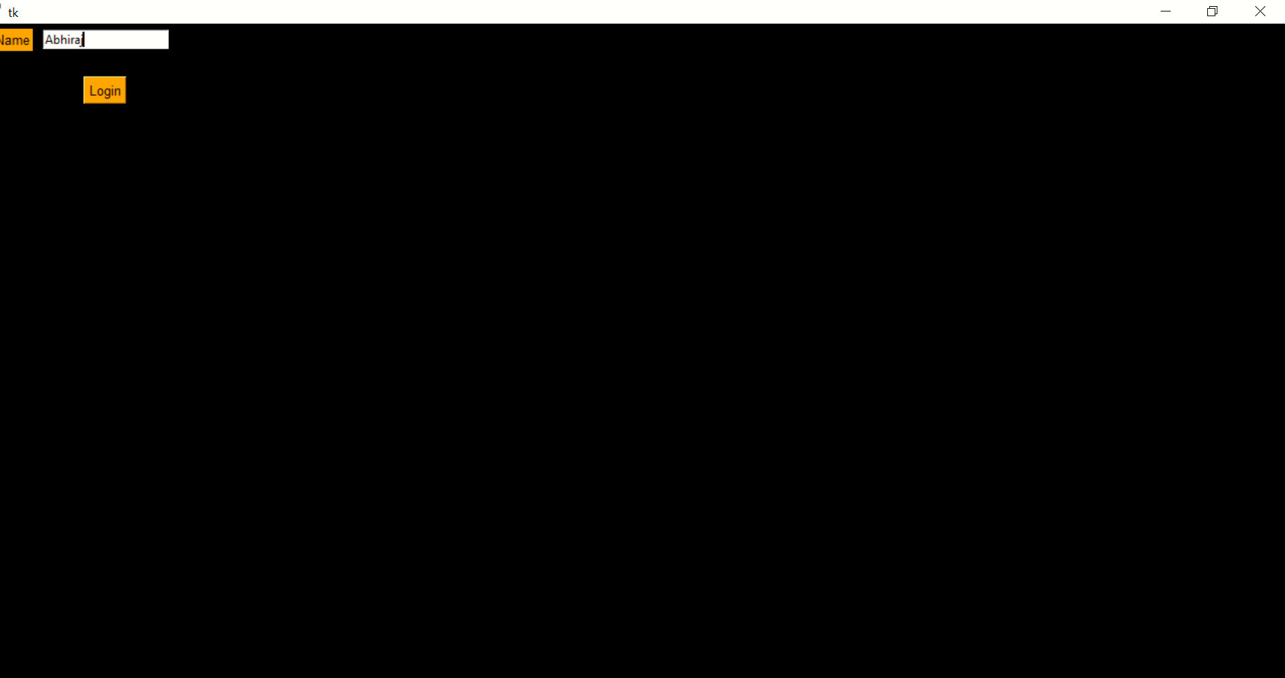
Login Page

Slide 11
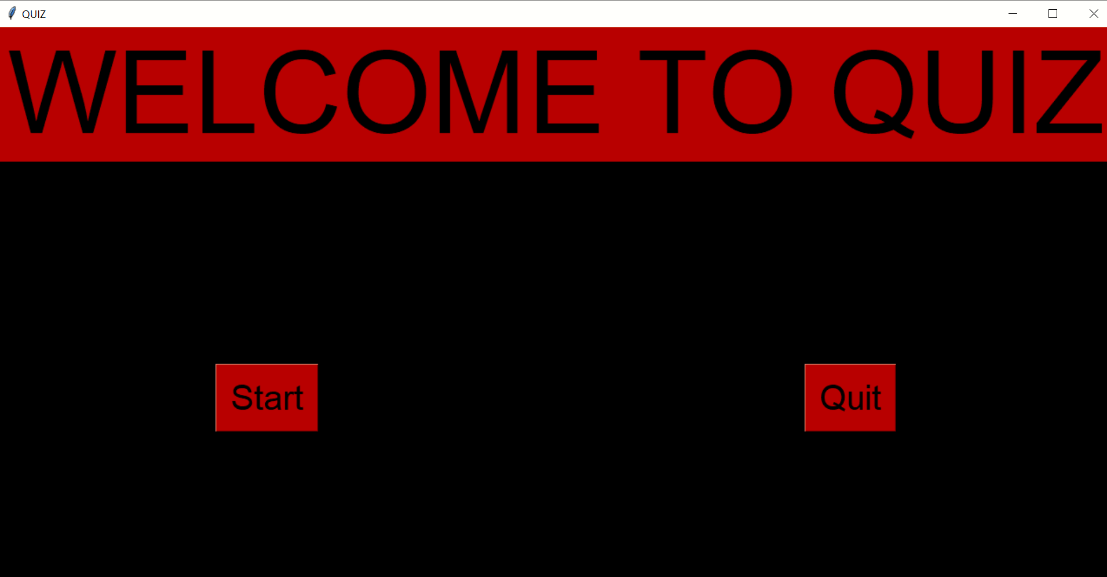
Home Page

Slide 12
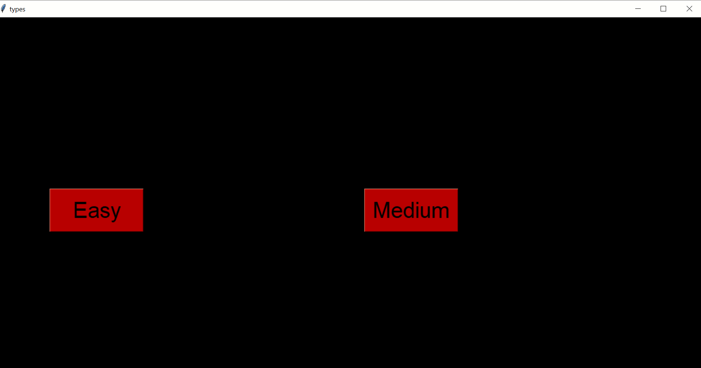
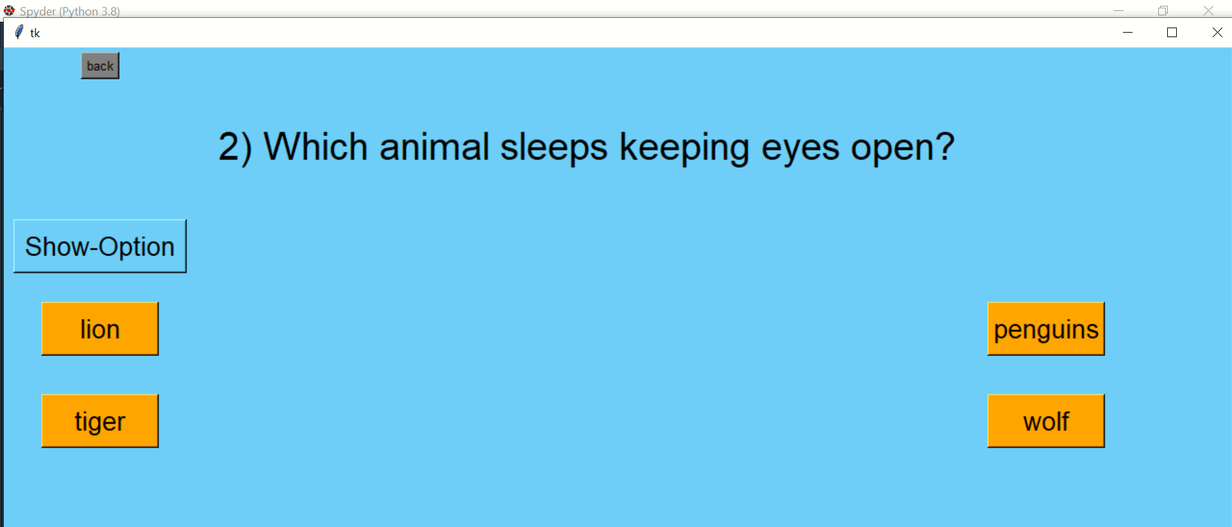
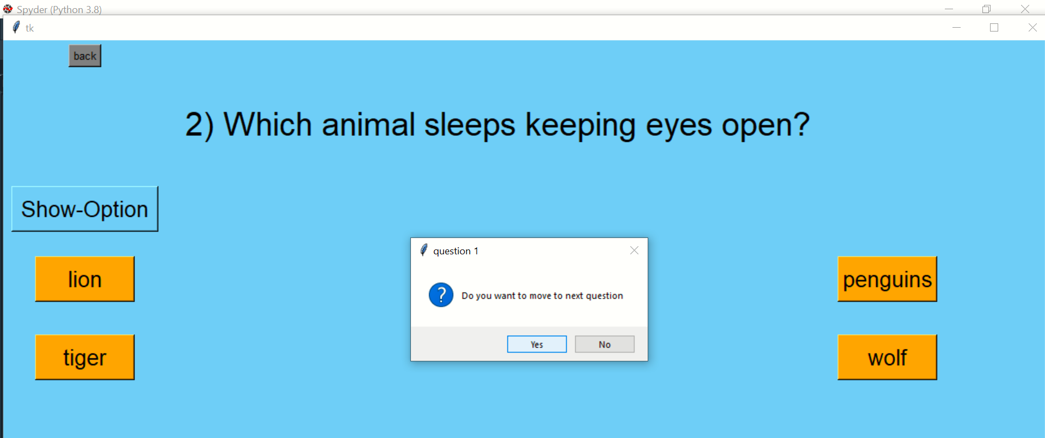
Level Selection And Questions

Slide 13
Summary
Why I choose Pyhton ?
Python offers multiple options for developing GUI (Graphical User Interface). Out of all the GUI methods, tkinter is the most commonly used method. It is a standard Python interface to the Tk GUI toolkit shipped with Python. Python with tkinter is the fastest and easiest way to create the GUI applications. Creating a GUI using tkinter is an asy task.
Technologies Used
Python 3.7
Tkinter Module
Aim
The main goal was to create a attractive and simple Quiz Application that can be used by everyone easily

Slide 14


